Slide 1
Exploring the Dynamics of Waves: An Insight into the Wave Equation
Henri Medeiros Dos Reis 12/6/2023

Slide 2
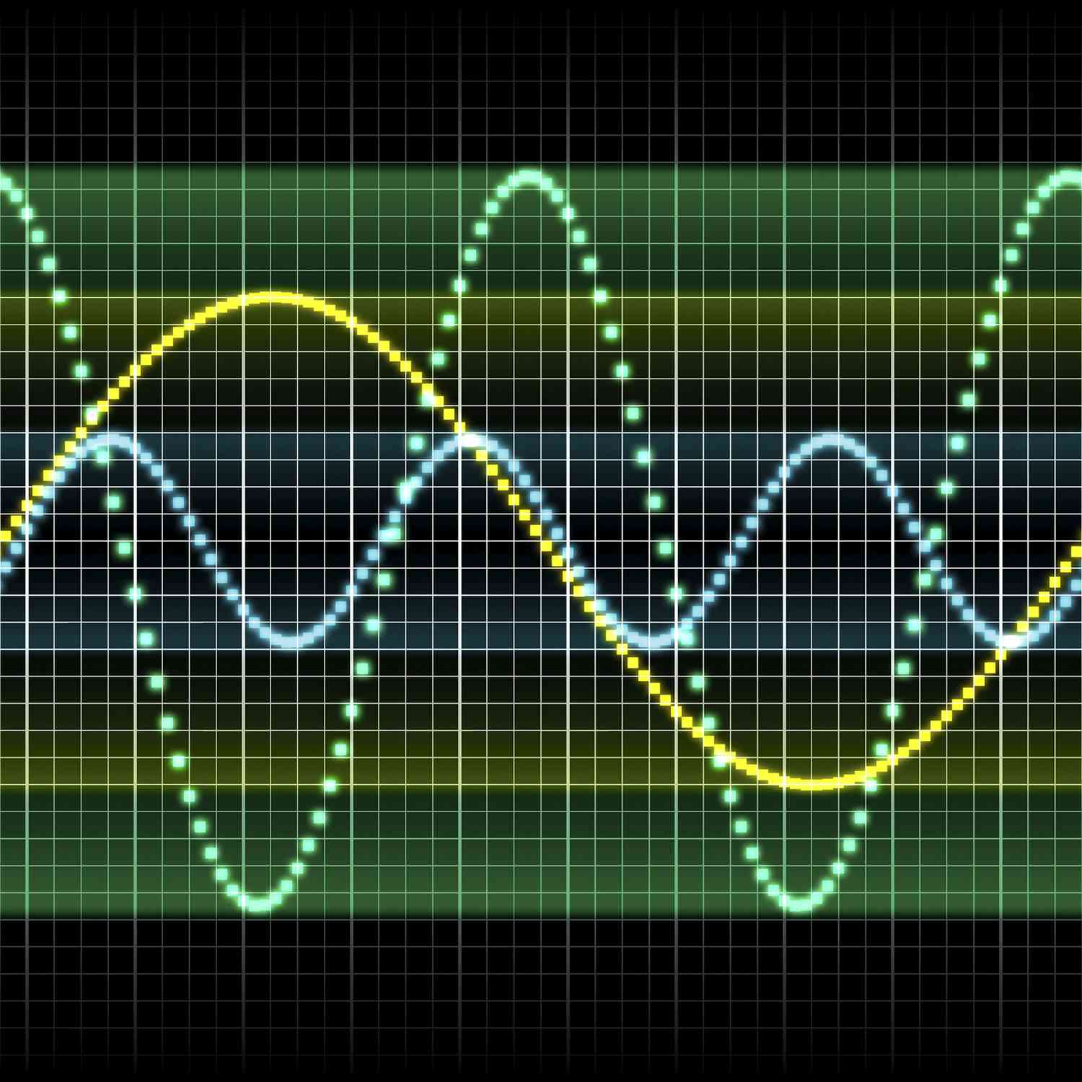
Introduction to Waves
Definition of Waves: Waves are oscillations that transfer energy through space. They are prevalent in nature and can manifest in various forms, from the ripples on a pond to the vibrations of a guitar string.

Slide 3
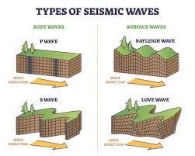
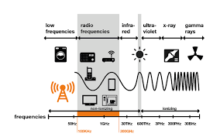
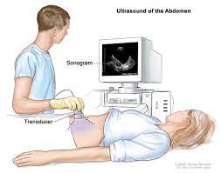
Importance of Understanding Waves
Applications: Waves play a crucial role in diverse fields such as physics, engineering, acoustics, and beyond.

Slide 4

Overview of the Wave Equation
The wave equation is a fundamental mathematical tool that describes the behavior of waves. It provides a concise framework for understanding how waves propagate. And can be mathematically represented by

Slide 5

One-Dimensional Wave Equation
In its simplest form, the one-dimensional wave equation is expressed as:
where u represents the wave function, t is time, x is spatial position, and c is the wave speed, and f is some disturbance.

Slide 6

Discretizing the Wave Equation
To solve the wave equation numerically, we begin by discretizing it. This involves breaking down the continuous wave equation into a finite set of points in both time and space.

Slide 7
Boundary Conditions - Reflect
Boundary conditions are essential for defining the behavior of waves and finding a solution. We'll explore two types: absorbing and reflecting.
Reflecting Boundary: Causes waves to bounce back into the domain, emulating a closed or reflective boundary.

Slide 8

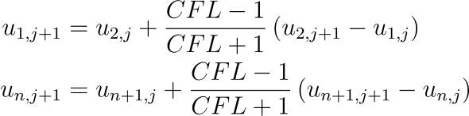

Boundary Conditions - Absorb
Absorbing Boundary: Allows waves to exit the computational domain without reflecting back, simulating an open boundary.
Which can be discretized to
Denote CFL =

Slide 9
Real-World Examples of Boundary Conditions
Absorbing Boundary Example: In oceanography, absorbing boundaries mimic waves dissipating as they reach the shore, providing accurate simulations of coastal regions.
Reflecting Boundary Example: In structural engineering, reflecting boundaries simulate waves bouncing back from structures, aiding in the study of wave interactions with buildings.

Slide 10
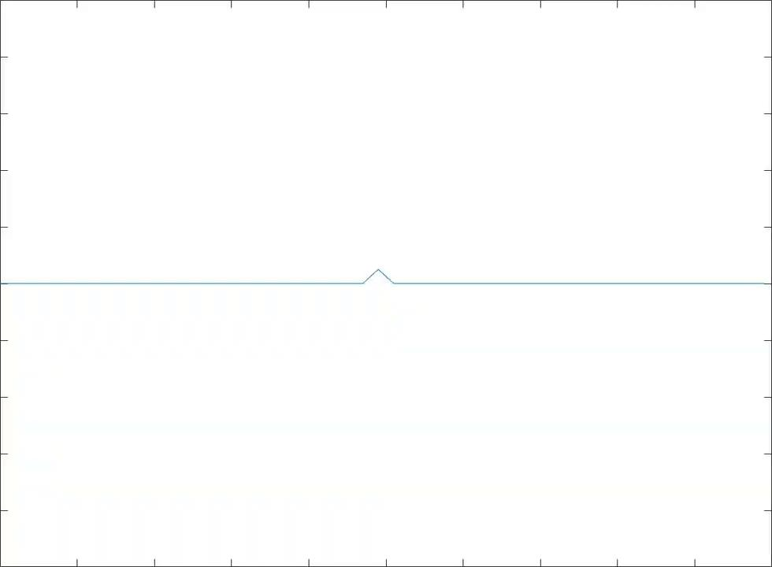
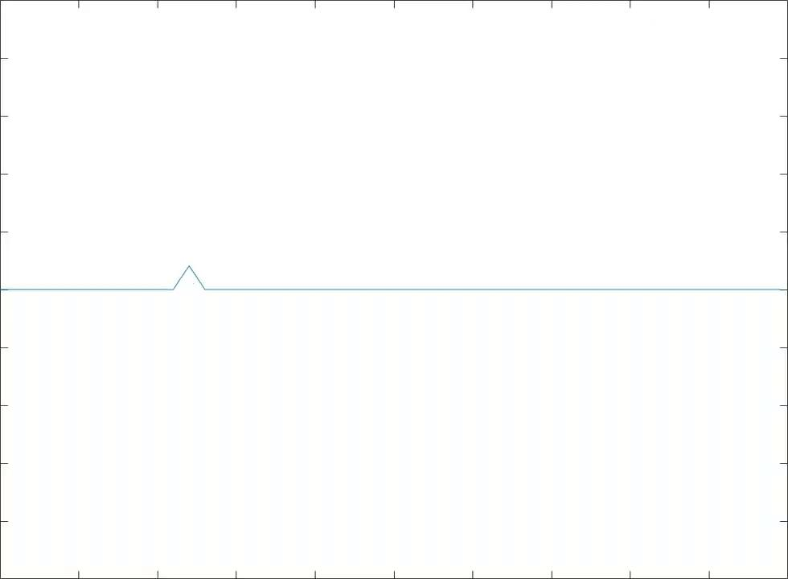
Simulations - 1D Wave Equation - Reflect

Slide 11

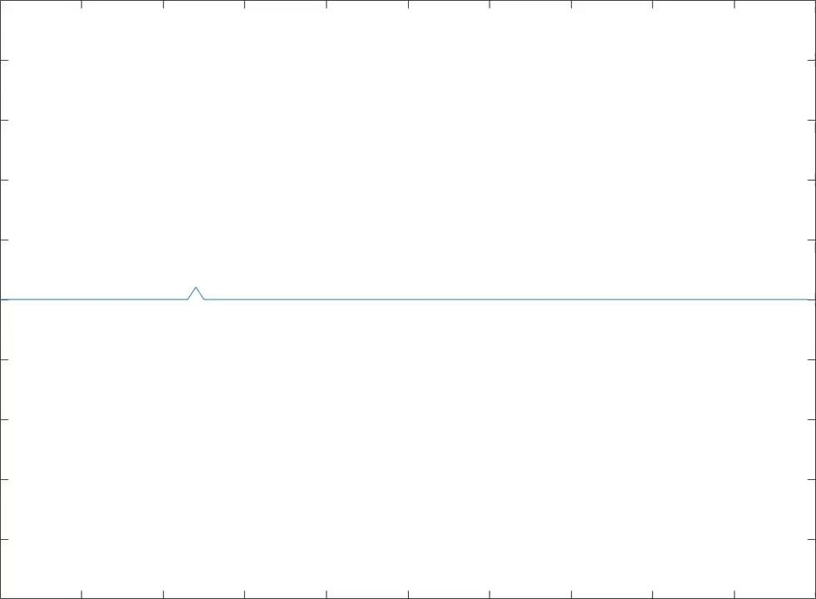
Simulations - 1D Wave Equation - Absorb

Slide 12

Extending to 2D
Extend our understanding to two dimensions, where waves propagate in both x and y directions.

Slide 13
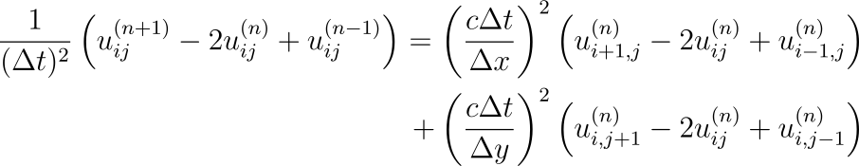
Discretizing the 2D wave equation
The equation in the previous slide can be discretized to

Slide 14
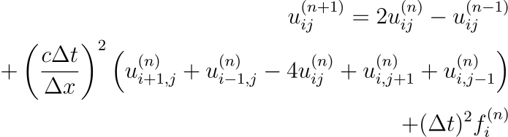
Discretizing the 2D wave equation
And for simplicity, we can let , then

Slide 15

Boundary Conditions - Reflect
And the boundary conditions are very similar
Where the subscript f means the final point in that direction

Slide 16
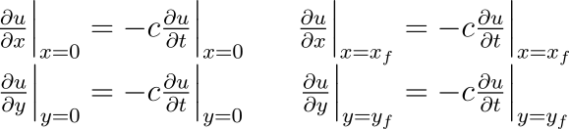
Boundary Conditions - Absorb
I did not include the discretization, since it follows the exact same form as in 1D, but with the same conditions in y as well.

Slide 17
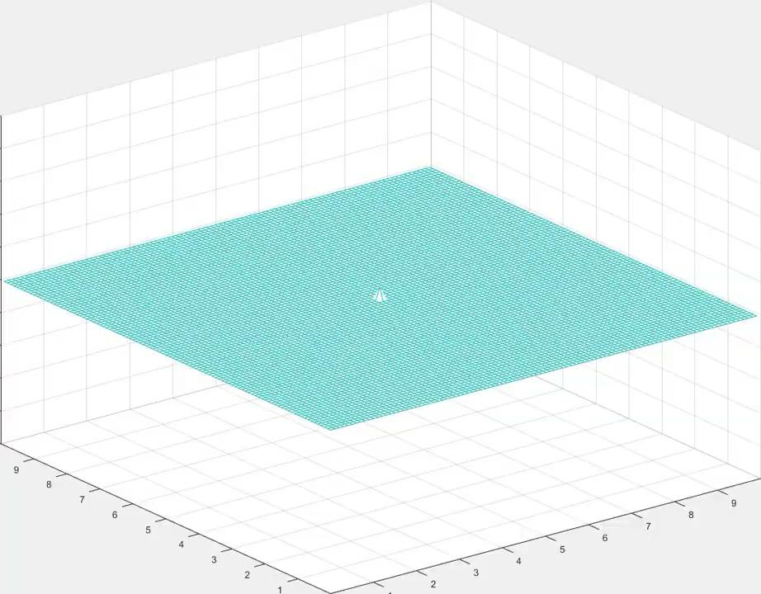
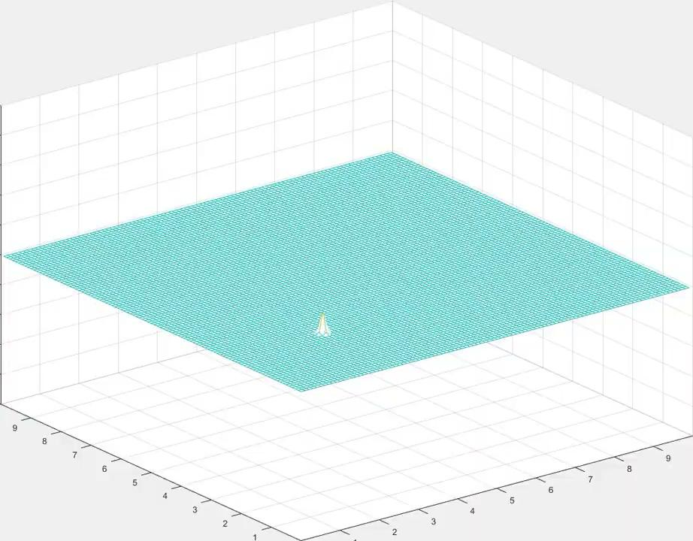
Simulations - 2D Wave Equation - Reflect

Slide 18

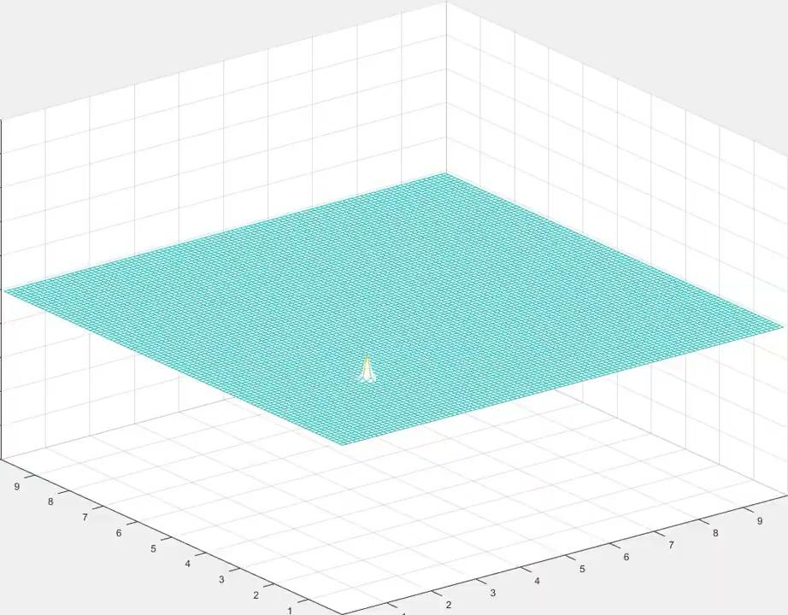
Simulations - 2D Wave Equation - Absorb

Slide 19
Extending to 3D
The equation can be extended in a similar fashion to 3D, or even ND space, but it is funny to think how waves would behave in higher dimensions and impossible to visualize.
Therefore, only simulations in 3D, since we can plot those.
Math was also omitted, same idea with more superscripts and subscripts.

Slide 20
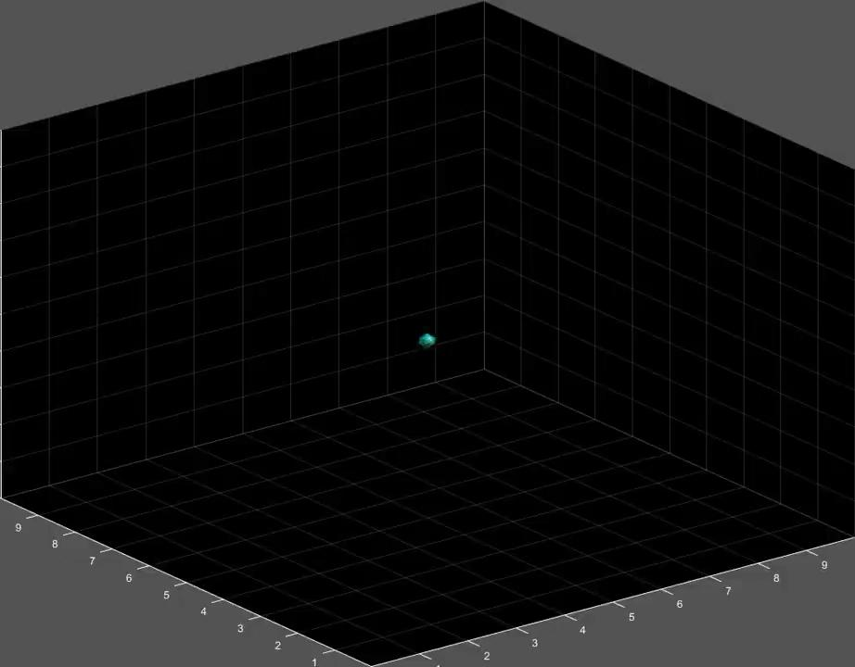
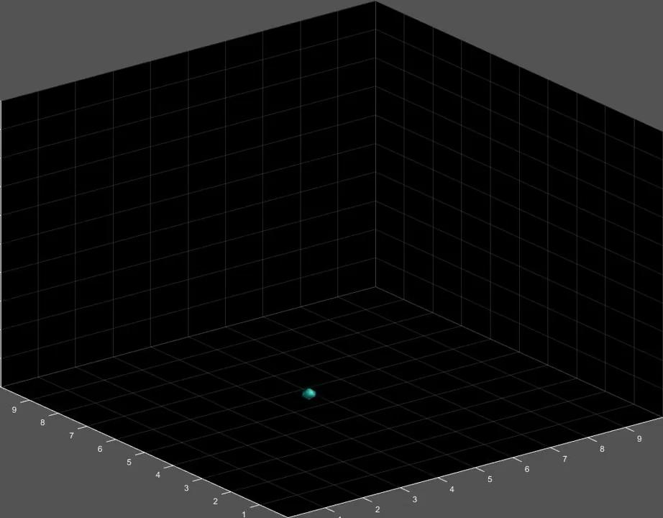
Simulations - 3D Wave Equation - Reflect

Slide 21

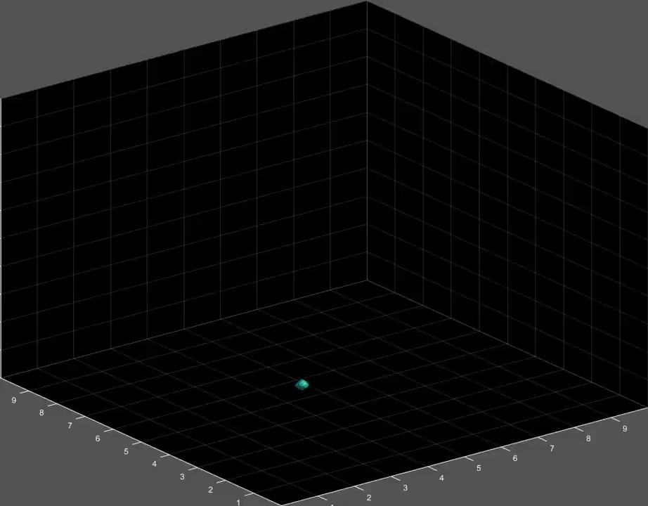
Simulations - 3D Wave Equation - Absorb

Slide 22
Sources
https://core.ac.uk/download/pdf/158320152.pdf. Discretization of the Mur’s boundary condition
https://www.mathworks.com/matlabcentral/fileexchange/115205-wave3d. Plot 3D in Matlab
Textbook for this class

Slide 23
Thank you!
Questions?

